Slide 1

GOVERNMENT SCHEME APPLICATION SYSTEM

Slide 2
TEAM MEMBERS :
FENIL SHAH
SAURABH JOSHI
SHANTANU KAUSHIK
SOURABH WATTAMWAR
SUKRITA MOHANDOSS
SURABHI KURIYAL
VARUN SHARMA
DIVIYANSHA AGARWAL

Slide 3
OVERVIEW :
The web-based system provides information about all the available government schemes.
Citizen can browse and apply for a scheme based on eligibility criteria. Once approved, the payment is directly credited to the citizen’s bank account.
FOR EMPLOYEE :
Employee Login
Add, Edit and Update Schemes
Logout
FOR CITIZEN :
Citizen Registration
Citizen Login
View and Apply to Schemes
Edit and Update Citizen Details
Logout

Slide 4
APPLICATION FEATURES :
MVC architecture is implemented
Login authentication
Validation is done while entering the details
JSON /XML files can be uploaded
Checks if user is Employee or Citizen
Checks if user is already logged in or not
Dynamic : Tables like eligibility criteria, ministry, sector can be extended
No data redundancy : data is normalized
Exception Handling is implemented
Unauthorized users do not have access

Slide 5
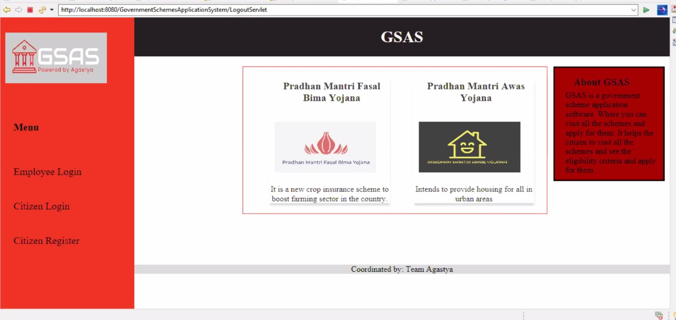
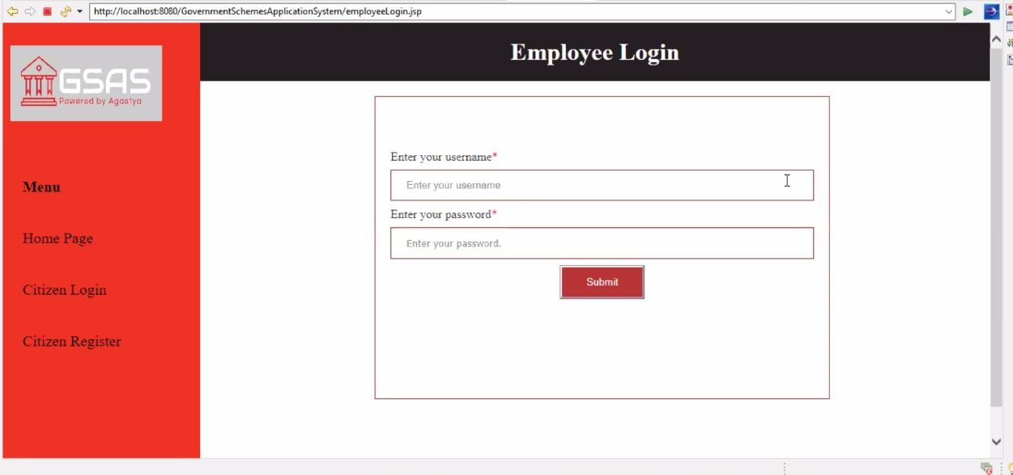
UI SNAPSHOTS :

Slide 6
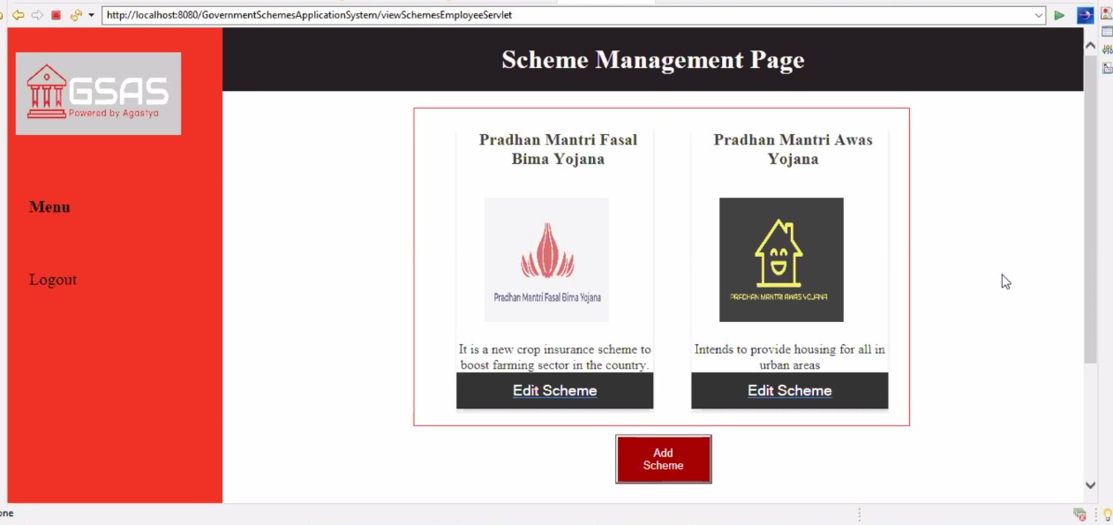
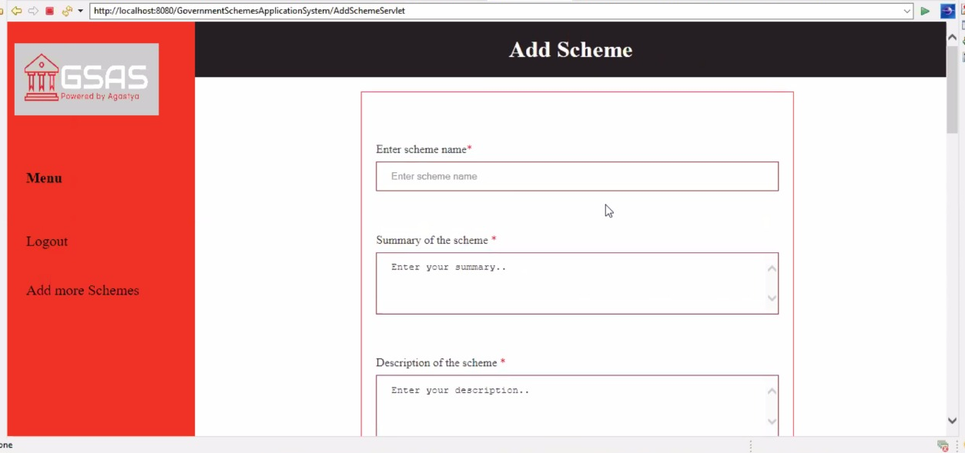
UI SNAPSHOTS :

Slide 7
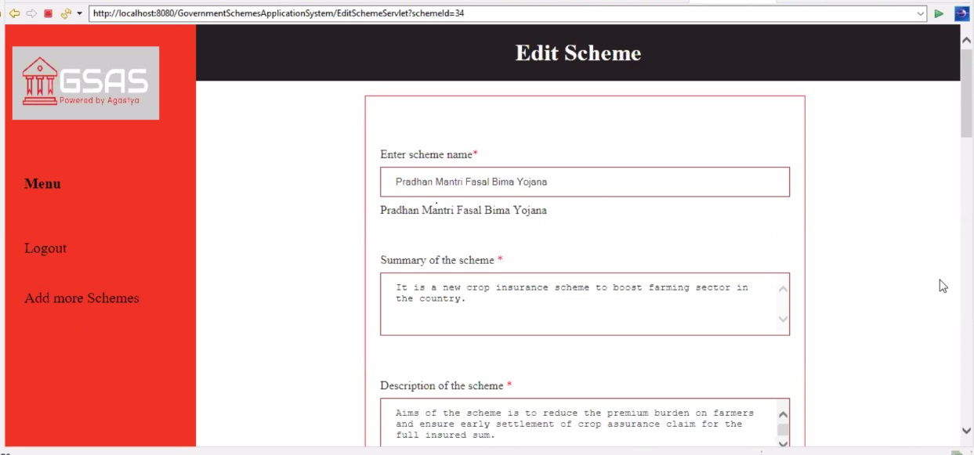
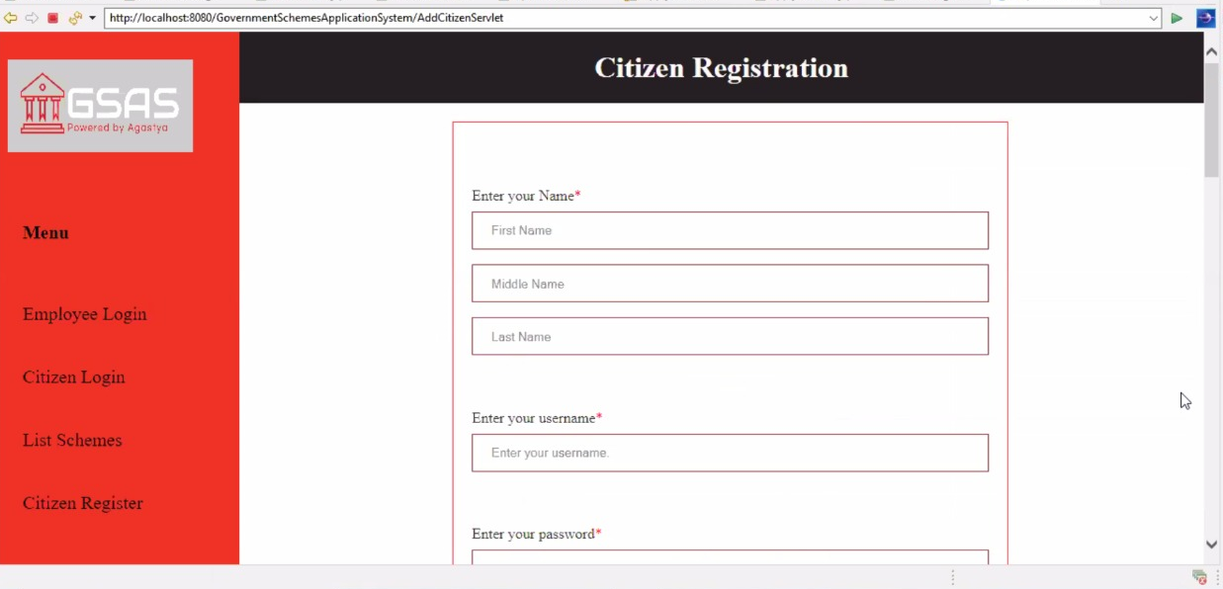
UI SNAPSHOTS :

Slide 8
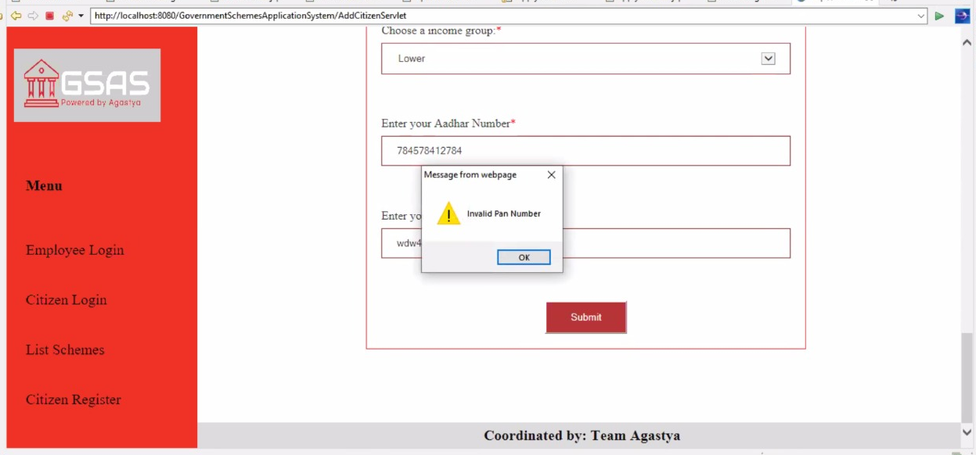

UI SNAPSHOTS :

Slide 9
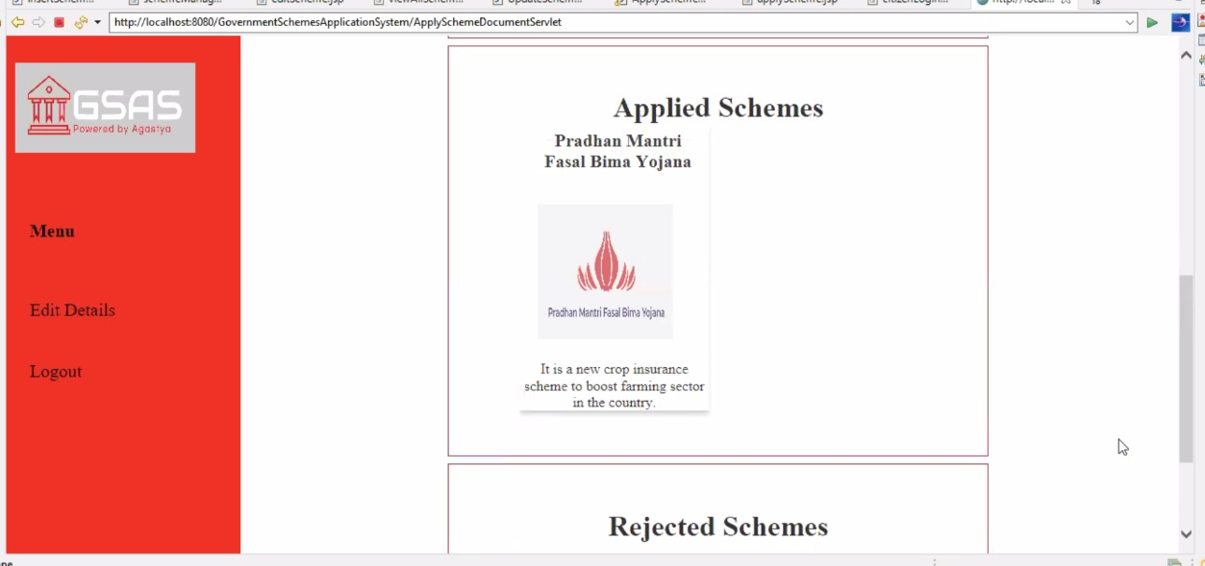
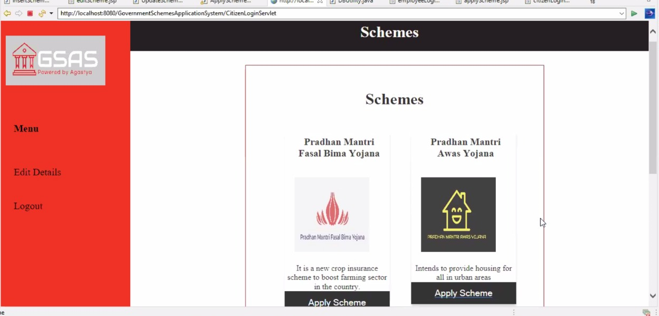
UI SNAPSHOTS :

Slide 10
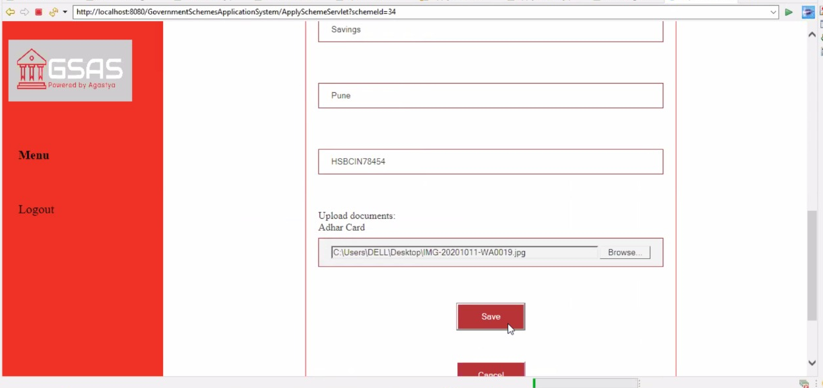

UI SNAPSHOTS :

Slide 11
CONCEPTS USED :
TOOLS USED :
Model View Controller Architecture
Java
Servlets
Exception Handling
Database Management
JSP
HTML
CSS
JSON
Eclipse Version 4.16.0
Apache Tomcat Version 8.5
Derby Database

Slide 12
THANK YOU

